Slide 1
FACE RECOGNITION

Slide 2
TEAM MEMBERS :
Chintan Solanke
Harshal Dhawad
Ishwari Matkar
Priyanshu Kalambe
GUIDED BY :
Dr. Jaishri Waghmare Mam
Prof. Gaurav Malande Sir

Slide 3
Content :
Introduction to Face Recognition.
How Face Recognition Works.
Code
Applications of Face Recognition.
Challenges and Concerns with Face Recognition.
Future Developments in Face Recognition.
Conclusion

Slide 4
Introduction to Face Recognition
Face recognition is a biometric technology that uses mathematical algorithms to identify and verify a person's identity based on their facial features.
The technology has become increasingly popular in recent years due to its convenience, accuracy, and potential applications in security, surveillance, and marketing.

Slide 5
How Face Recognition Works
Face recognition works by analyzing specific facial features such as the distance between the eyes, the shape of the nose, and the contours of the jawline.
These features are then converted into a mathematical representation called a faceprint, which is compared to a database of known faces to determine a match.

Slide 6
Code :
import cv2
import numpy as np
import face_recognition
import os
from datetime import datetime
path = 'Training_images'
images = []
classNames = []
myList = os.listdir(path)
print(myList)
for cl in myList:
curImg = cv2.imread(f'{path}/{cl}')
images.append(curImg)
classNames.append(os.path.splitext(cl)[0])
print(classNames)

Slide 7
def findEncodings(images):
encodeList = []
for img in images:
img = cv2.cvtColor(img, cv2.COLOR_BGR2RGB)
encode = face_recognition.face_encodings(img)[0]
encodeList.append(encode)
return encodeList
def markAttendance(name):
with open('Attendance.csv', 'r+') as f:
myDataList = f.readlines()
nameList = []
for line in myDataList:
entry = line.split(',')
nameList.append(entry[0])
if name not in nameList:
now = datetime.now()
dtString = now.strftime('%H:%M:%S')
f.writelines(f'\n{name},{dtString}')

Slide 8
while True:
success, img = cap.read()
imgS = cv2.resize(img, (0, 0), None, 0.25, 0.25)
imgS = cv2.cvtColor(imgS, cv2.COLOR_BGR2RGB)
facesCurFrame = face_recognition.face_locations(imgS)
encodesCurFrame = face_recognition.face_encodings(imgS, facesCurFrame)
for encodeFace, faceLoc in zip(encodesCurFrame, facesCurFrame):
matches = face_recognition.compare_faces(encodeListKnown, encodeFace)
faceDis = face_recognition.face_distance(encodeListKnown, encodeFace)
matchIndex = np.argmin(faceDis)
if matches[matchIndex]:
name = classNames[matchIndex].upper()
y1, x2, y2, x1 = faceLoc
y1, x2, y2, x1 = y1 * 4, x2 * 4, y2 * 4, x1 * 4
cv2.rectangle(img, (x1, y1), (x2, y2), (0, 255, 0), 2)
cv2.rectangle(img, (x1, y2 - 35), (x2, y2), (0, 255, 0), cv2.FILLED)
cv2.putText(img, name, (x1 + 6, y2 - 6), cv2.FONT_HERSHEY_COMPLEX, 1,
(255, 255, 255), 2)
markAttendance(name)
cv2.imshow('Webcam', img)
cv2.waitKey(1)

Slide 9
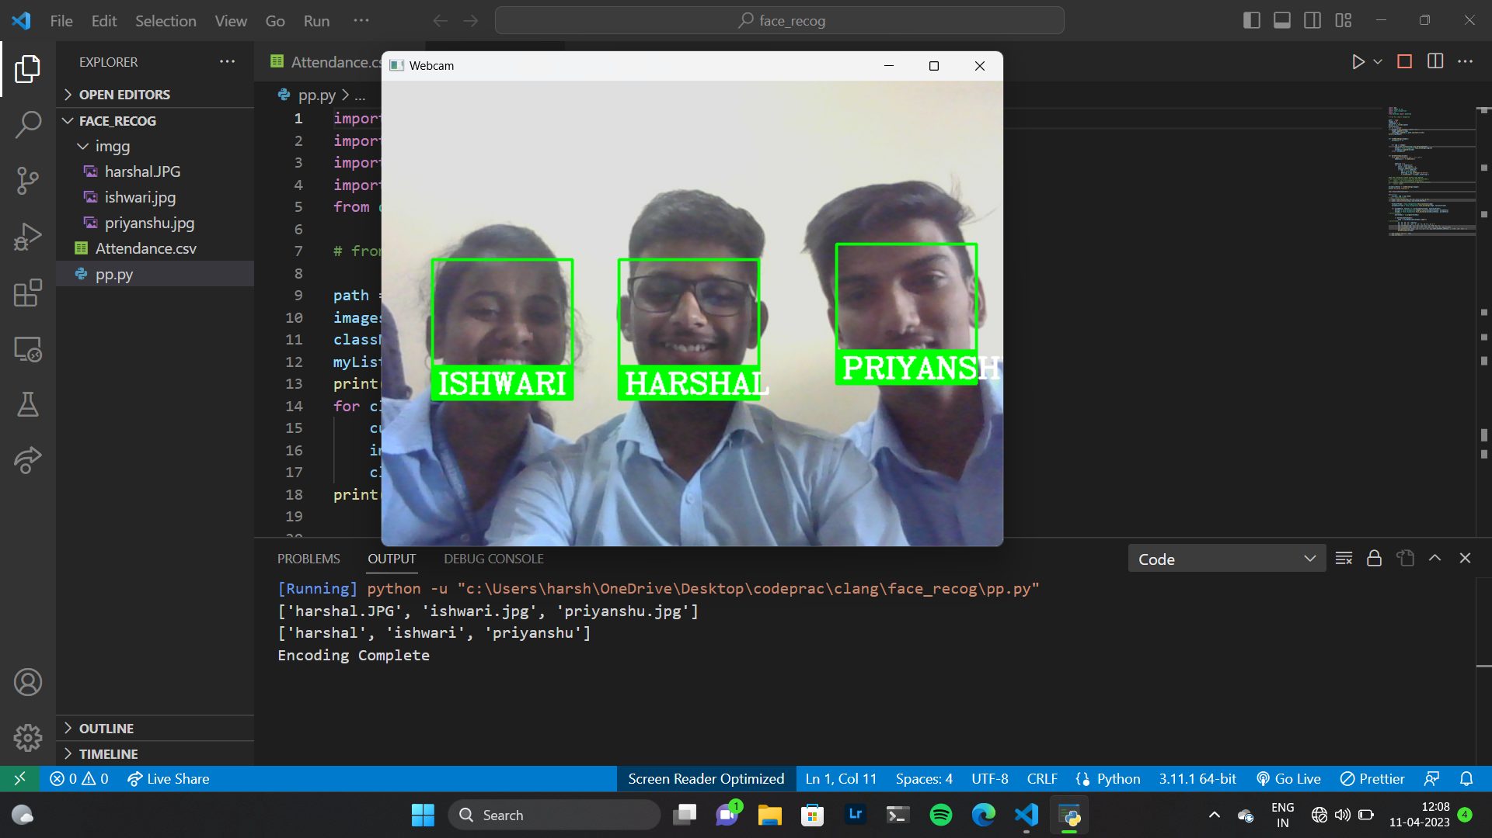
Output:-

Slide 10
Challenges and Concerns with Face Recognition
Despite its potential benefits, face recognition technology also raises several concerns related to privacy, bias, and accuracy.
There have been instances where the technology has misidentified individuals, particularly people of color and women, leading to false accusations and wrongful arrests.

Slide 11
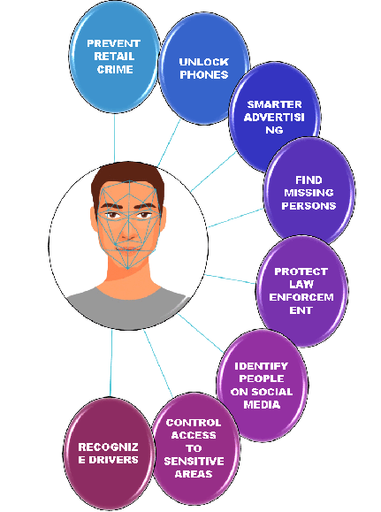
Applications of Face Recognition
Face recognition technology has a wide range of potential applications, from security and law enforcement to marketing and entertainment.
In security, it can be used for access control, border control, and surveillance. In marketing, it can be used for targeted advertising and customer analysis.

Slide 12
Future Developments in Face Recognition
As face recognition technology continues to evolve, researchers are exploring new ways to improve its accuracy and address its limitations.
This includes developing more sophisticated algorithms, incorporating additional biometric data such as voice and gait recognition, and implementing stricter regulations and ethical guidelines.

Slide 13
Conclusion
Face recognition technology has the potential to revolutionize the way we interact with the world around us, but it also comes with significant challenges and concerns.
As we continue to develop and refine this technology, it is important to consider its implications for privacy, fairness, and social justice.

Slide 14
THANK YOU!!

